Slide 1
Retail Positioning
Unit 5

Slide 2
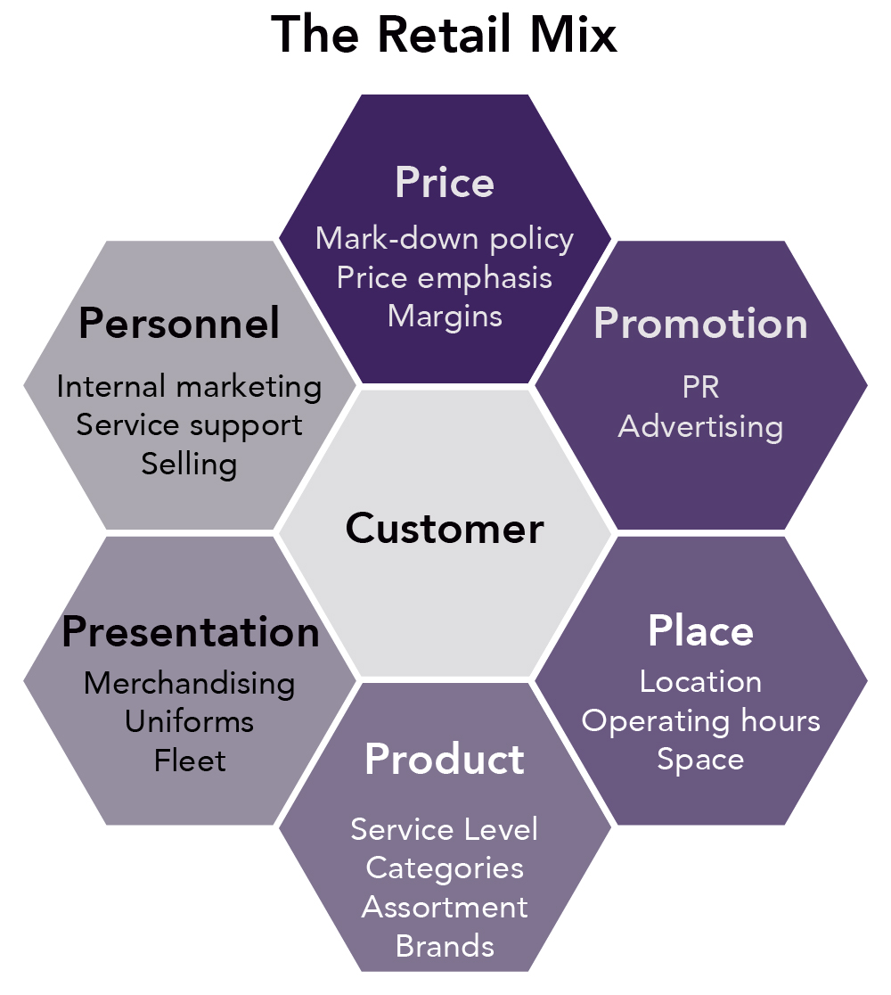

Slide 3
Merchandising, Inventory & Logistics

Slide 4
Merchandise Budget Planning
Merchandise Groupings
Operating Ratios
Markdown Strategy

Slide 5
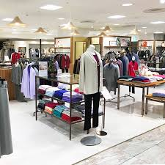
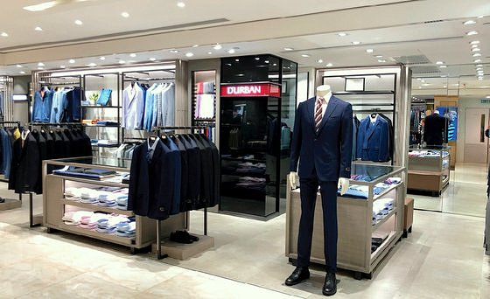
Merchandise Groupings
Grouping merchandise into departments and classifications is one of the most important things to ensure retail success

Slide 6
Key Operating Ratios
Stock Turnover Rate refers to the number of times that the average stock is sold during a given period of time
Stock turnover rate = Net sales/Average inventory
Stock-to-Sale Ratio indicates the relationship between planned sales and the amount of inventory required to produce those sales
Stock-to-sale ratio = Beginning of month inventory at selling price/Total sales for the month

Slide 7
Cont..,
Gross Margin Return on Inventory Investment (GMROII) is a measurement of the profitability of a retailer’s sales.
GMROII = Gross margin in dollars/Average inventory at cost
Sales per Square Foot refers to net sales divided by square feet of selling space.
Sales per square foot = Net annual sales/Total selling area in square feet

Slide 8
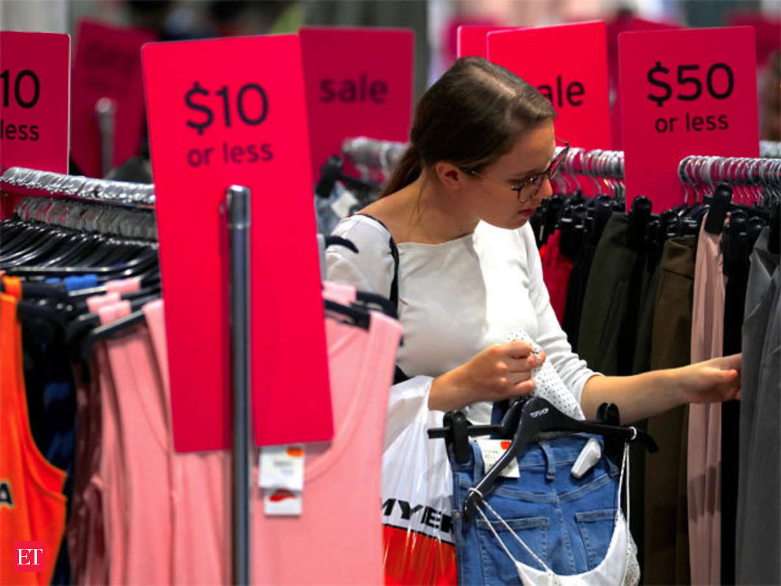

Markdown Strategies
Promotional markdowns and regular markdowns are mainly applicable to transactional pop-up operations, such as a warehouse sale. Other types of pop-up retailers can use the two markdown strategies on limited merchandise to create the spurt-of-the-moment feeling for shoppers.

Slide 9
Merchandise Assortment Planning
Merchandise selection requires careful analysis of:
  The Store’s Goals And Objectives
  The Types of Products Offered
  Past Sales Records
  The Target Market
  Other Factors might impact sales

Slide 10
Retailer Pricing Techniques
Target market
Store policies
Competition
Economic conditions

Slide 11
Open-to-Buy (OTB)
Open-to-Buy (OTB) is the amount of funds available for buyers to make new purchases.
OTB = Budgeted end-of-the-period stock + Budgeted sales + Budgeted reductions (markdowns, thefts) − Beginning-of-the-period inventory − Purchases already received − Purchase orders placed but not yet received

Slide 12
Logistics & Retail Management: Challenges and Strategies
Storage facilities
Inventory
Transportation
Unitization and Packaging
Communication

Slide 13
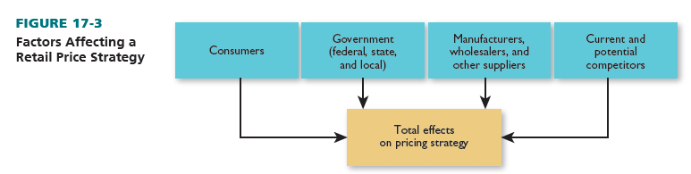
External Factors Affecting a Retail Price Strategy

Slide 14

The Consumer and Retail Pricing
Economic Consumers
Status-oriented Consumers
Assortment-oriented Consumers
Personalizing consumers
Convenience-oriented Consumers

Slide 15
The Government and Retail Pricing
HORIZONTAL PRICE FIXING
VERTICAL PRICE FIXING
PRICE DISCRIMINATION
MINIMUM-PRICE LAWS
UNIT PRICING
ITEM PRICE REMOVAL
PRICE ADVERTISING

Slide 16
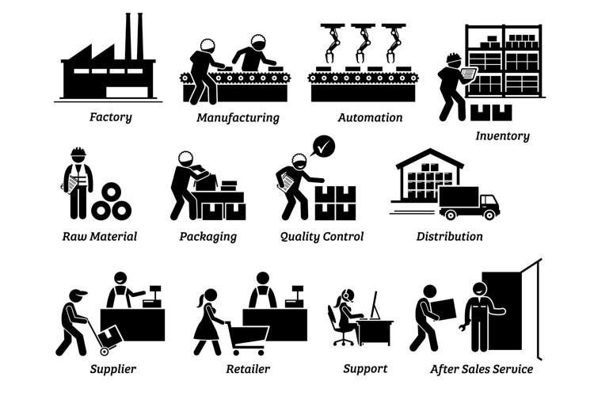
Manufacturers, Wholesalers, and Other Suppliers—and Retail Pricing
Many manufacturers set prices to retailers by estimating final retail prices and then subtract­ing required retailer and wholesaler profit margins.

Slide 17

Competition and Retail Pricing
Market pricing occurs when shoppers have a large choice of retailers.
In this instance, retailers often price similarly to each other and have less control over price because consumers can easily shop around.

